Slide 1

Galerkin and Variational Methods
23PHY114
Lecture 4
Dr. Mrittunjoy Guha Majumdar
School of Artificial Intelligence, Amrita Vishwavidyapeetham Delhi NCR

Slide 2
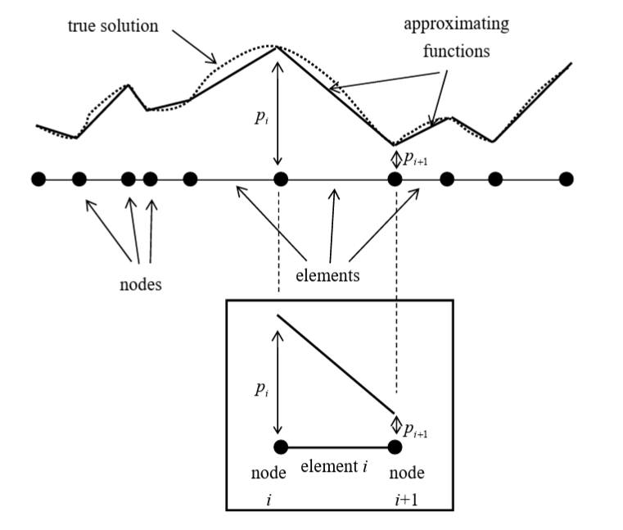
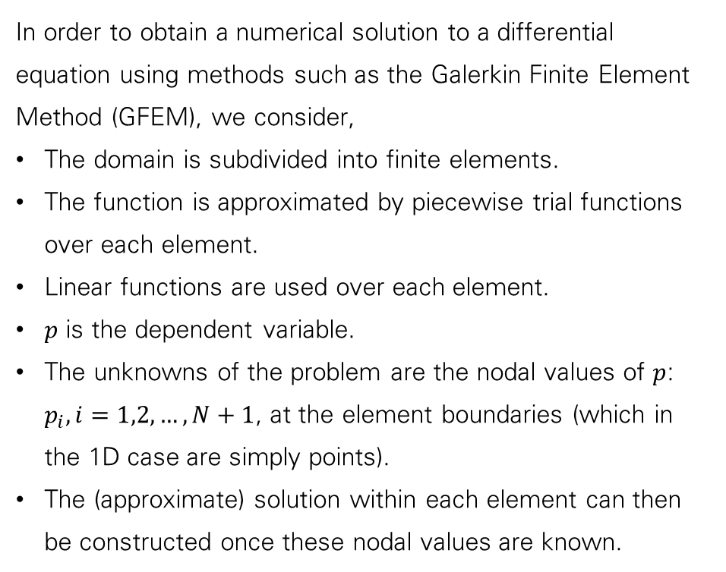
Approximate Solution and Nodal Values
In order to obtain a numerical solution to a differential equation using methods such as the Galerkin Finite Element Method (GFEM), we consider,
The domain is subdivided into finite elements.
The function is approximated by piecewise trial functions over each element.
Linear functions are used over each element.
$p$ is the dependent variable.
The unknowns of the problem are the nodal values of $p$: $p_{i}, i=1,2,…,N+1$, at the element boundaries (which in the 1D case are simply points).
The (approximate) solution within each element can then be constructed once these nodal values are known.

Slide 3
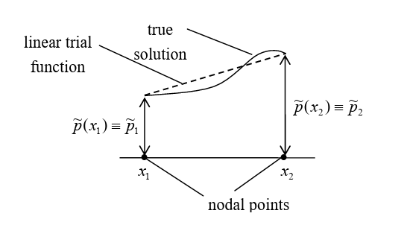
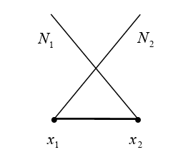
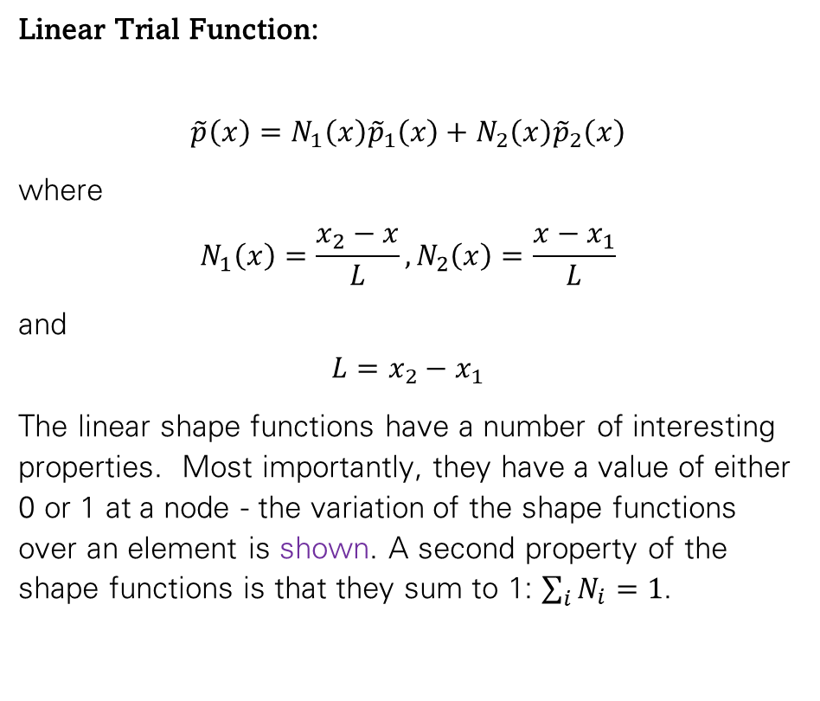
Trial Functions
Linear Trial Function:
$$\tilde{p}\left(x\right)=N_{1}\left(x\right){\tilde{p}}_{1}\left(x\right)+N_{2}\left(x\right){\tilde{p}}_{2}\left(x\right)$$
where
$$N_{1}\left(x\right)=\frac{x_{2}−x}{L},N_{2}\left(x\right)=\frac{x−x_{1}}{L}$$
and
$$L=x_{2}−x_{1}$$
The linear shape functions have a number of interesting properties. Most importantly, they have a value of either 0 or 1 at a node - the variation of the shape functions over an element is shown. A second property of the shape functions is that they sum to 1: $\sum_{i}{N_{i}}=1$.

Slide 4
Calculus of Variation and Rayleigh-Ritz Method

Slide 5
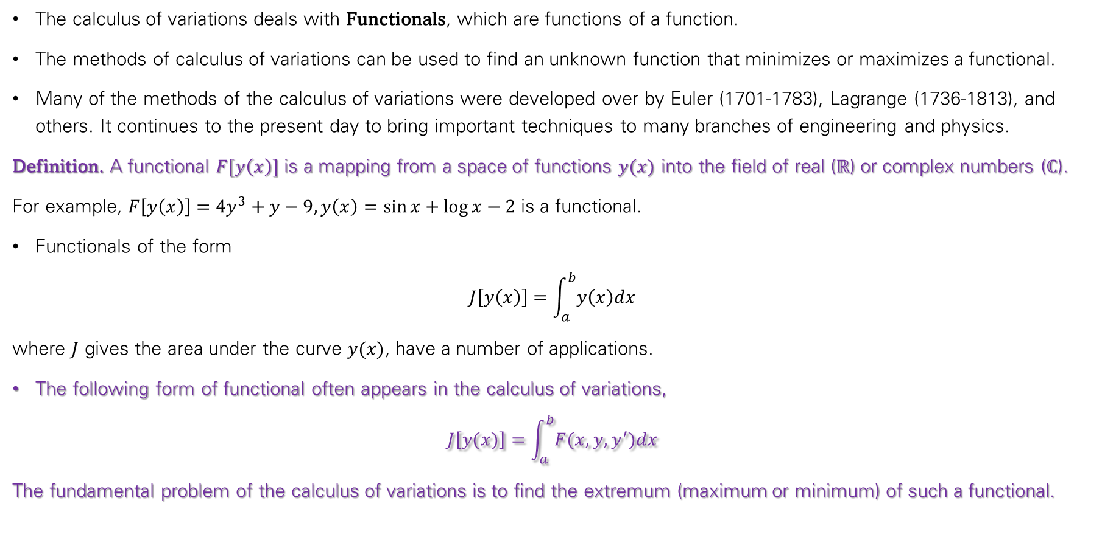
Calculus of Variations
The calculus of variations deals with Functionals, which are functions of a function.
The methods of calculus of variations can be used to find an unknown function that minimizes or maximizes a functional.
Many of the methods of the calculus of variations were developed over by Euler (1701-1783), Lagrange (1736-1813), and others. It continues to the present day to bring important techniques to many branches of engineering and physics.
Definition. A functional $F[y\left(x\right)]$ is a mapping from a space of functions $y(x)$ into the field of real ($ℝ$) or complex numbers ($ℂ$).
For example, $F\left[y\left(x\right)\right]=4y^{3}+y−9, y\left(x\right)=\sin{x}+\log{x}−2$ is a functional.
Functionals of the form
$$J\left[y\left(x\right)\right]=\int_{a}^{b}{y\left(x\right)dx}$$
where $J$ gives the area under the curve $y(x)$, have a number of applications.
The following form of functional often appears in the calculus of variations,
$$J\left[y(x)\right]=\int_{a}^{b}{F(x,y,y^{′})dx}$$
The fundamental problem of the calculus of variations is to find the extremum (maximum or minimum) of such a functional.

Slide 6
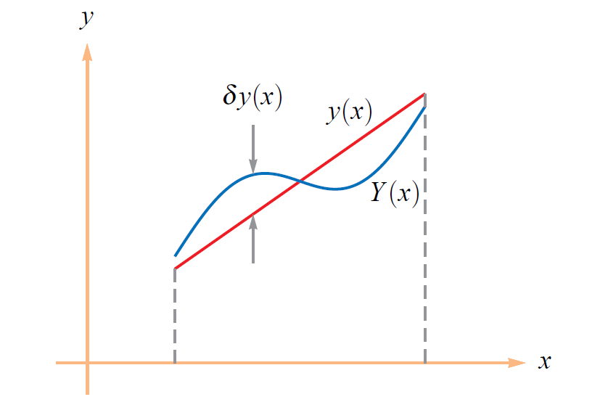
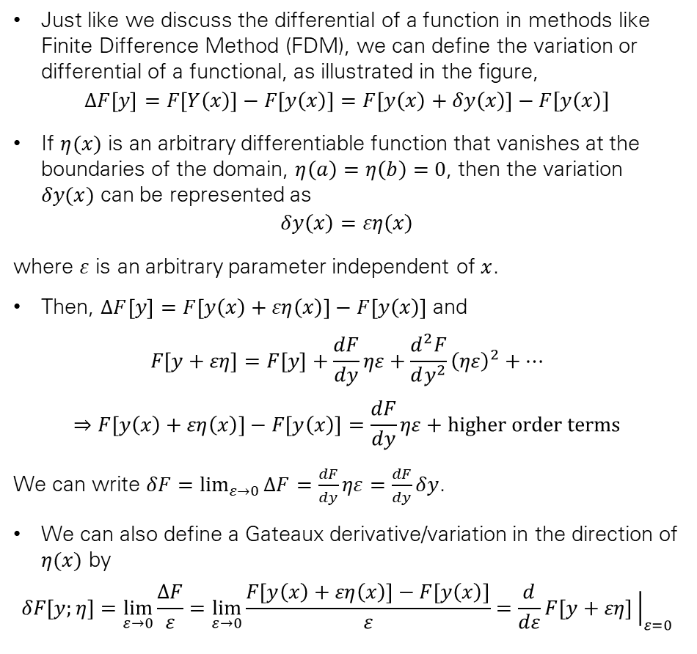
Variation/Differential of a Functional
Just like we discuss the differential of a function in methods like Finite Difference Method (FDM), we can define the variation or differential of a functional, as illustrated in the figure,
$$ΔF\left[y\right]=F\left[Y\left(x\right)\right]−F\left[y\left(x\right)\right]=F\left[y\left(x\right)+δy\left(x\right)\right]−F[y\left(x\right)]$$
If $η(x)$ is an arbitrary differentiable function that vanishes at the boundaries of the domain, $η\left(a\right)=η\left(b\right)=0$, then the variation $δy(x)$ can be represented as
$$δy\left(x\right)=εη\left(x\right)$$
where $ε$ is an arbitrary parameter independent of $x$.
Then, $ΔF\left[y\right]=F\left[y\left(x\right)+εη\left(x\right)\right]−F\left[y\left(x\right)\right]$ and
$$F\left[y+εη\right]=F\left[y\right]+\frac{dF}{dy}ηε+\frac{d^{2}F}{dy^{2}}{\left(ηε\right)}^{2}+…$$
$$⇒F\left[y\left(x\right)+εη\left(x\right)\right]−F\left[y\left(x\right)\right]=\frac{dF}{dy}ηε+higher order terms$$
We can write $δF=\lim_{ε→0}{ΔF}=\frac{dF}{dy}ηε=\frac{dF}{dy}δy$.
We can also define a Gateaux derivative/variation in the direction of $η(x)$ by
$$δF\left[y;η\right]=\lim_{ε→0}{\frac{ΔF}{ε}}=\lim_{ε→0}{\frac{F\left[y\left(x\right)+εη\left(x\right)\right]−F\left[y\left(x\right)\right]}{ε}}=\frac{d}{dε}F\left[y+εη\right]{\left.​\right|}_{ε=0}$$
Illustration of variation of functions.

Slide 7
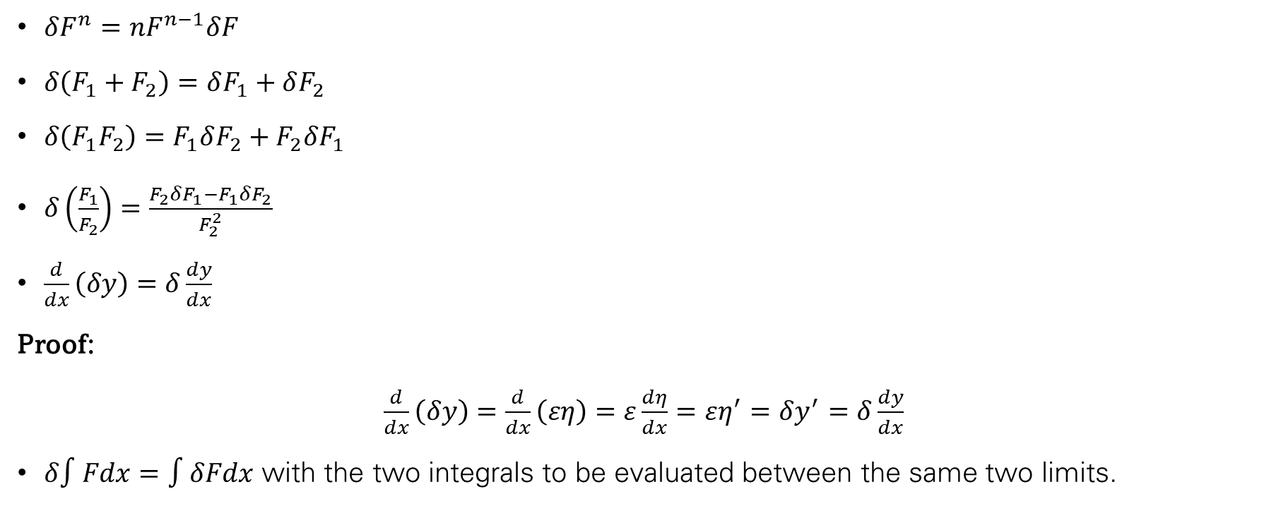
Rules of Variational Calculus
$δF^{n}=nF^{n−1}δF$
$δ\left(F_{1}+F_{2}\right)=δF_{1}+δF_{2}$
$δ\left(F_{1}F_{2}\right)=F_{1}δF_{2}+F_{2}δF_{1}$
$δ\left(\frac{F_{1}}{F_{2}}\right)=\frac{F_{2}δF_{1}−F_{1}δF_{2}}{F_{2}^{2}}$
$\frac{d}{dx}\left(δy\right)=δ\frac{dy}{dx}$
Proof:
$\frac{d}{dx}\left(δy\right)=$ $\frac{d}{dx}\left(εη\right)=ε\frac{dη}{dx}=εη^{′}=δy^{′}=δ\frac{dy}{dx}$
$δ∫Fdx=∫δFdx$ with the two integrals to be evaluated between the same two limits.

Slide 8
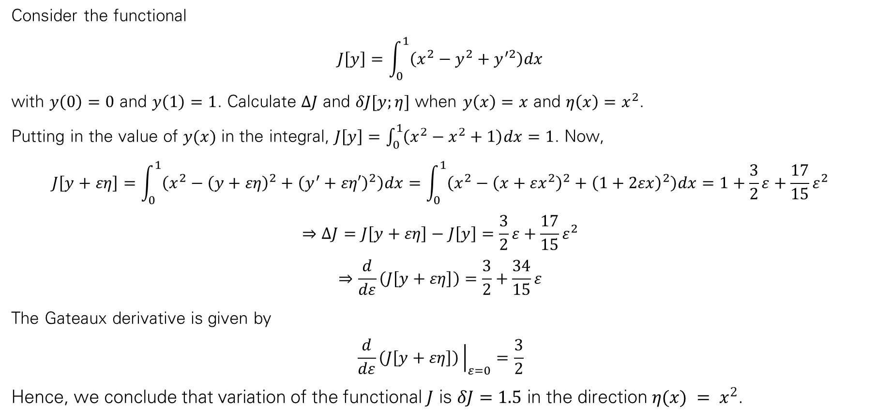
Example
Consider the functional
$$J\left[y\right]=\int_{0}^{1}{\left(x^{2}−y^{2}+y^{′2}\right)dx}$$
with $y\left(0\right)=0$ and $y\left(1\right)=1$. Calculate $ΔJ$ and $δJ[y;η]$ when $y\left(x\right)=x$ and $η\left(x\right)=x^{2}$.
Putting in the value of $y(x)$ in the integral, $J\left[y\right]=\int_{0}^{1}{\left(x^{2}−x^{2}+1\right)dx}=1$. Now,
$$J\left[y+εη\right]=\int_{0}^{1}{\left(x^{2}−{\left(y+εη\right)}^{2}+{\left(y^{′}+εη′\right)}^{2}\right)dx}=\int_{0}^{1}{\left(x^{2}−{\left(x+εx^{2}\right)}^{2}+{\left(1+2εx\right)}^{2}\right)dx}=1+\frac{3}{2}ε+\frac{17}{15}ε^{2}$$
$$⇒ΔJ=J\left[y+εη\right]−J\left[y\right]=\frac{3}{2}ε+\frac{17}{15}ε^{2}$$
$$⇒\frac{d}{dε}\left(J\left[y+εη\right]\right)=\frac{3}{2}+\frac{34}{15}ε$$
The Gateaux derivative is given by
$$\frac{d}{dε}\left(J\left[y+εη\right]\right){\left.​\right|}_{ε=0}=\frac{3}{2}$$
Hence, we conclude that variation of the functional $J$ is $δJ=1.5$ in the direction $η(x) = x^{2}$.

Slide 9
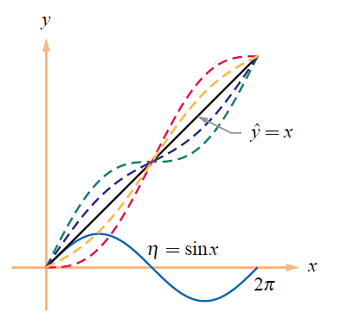
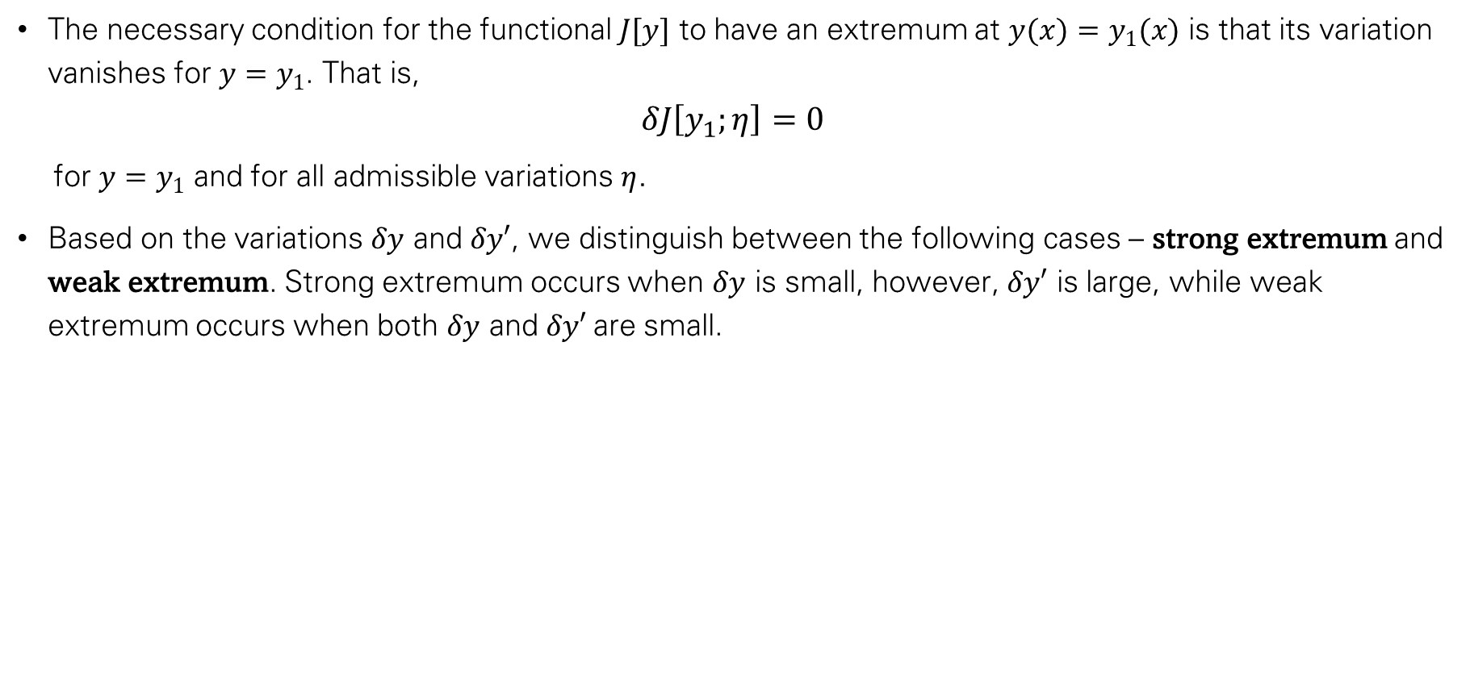
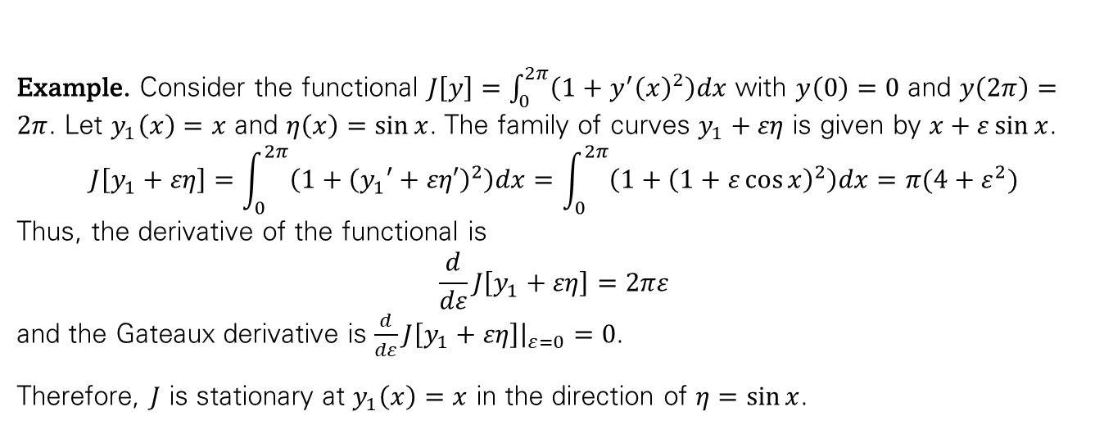
Maxima and Minima of Functional
The necessary condition for the functional $J[y]$ to have an extremum at $y(x)=y_{1}(x)$ is that its variation vanishes for $y=y_{1}$. That is,
$$δJ\left[y_{1};η\right]=0$$
  for $y=y_{1}$ and for all admissible variations $η$.
Based on the variations $δy$ and $δy′$, we distinguish between the following cases – strong extremum and weak extremum. Strong extremum occurs when $δy$ is small, however, $δy′$ is large, while weak extremum occurs when both $δy$ and $δy′$are small.
Example. Consider the functional $J\left[y\right]=\int_{0}^{2π}{\left(1+y^{′}{\left(x\right)}^{2}\right)dx}$ with $y\left(0\right)=0$ and $y\left(2π\right)=2π$. Let $y_{1}\left(x\right)=x$ and $η\left(x\right)=\sin{x}$. The family of curves $y_{1}+εη$ is given by $x+ε\sin{x}$.
$$J\left[y_{1}+εη\right]=\int_{0}^{2π}{\left(1+{\left(y_{1}′+εη′\right)}^{2}\right)dx}=\int_{0}^{2π}{\left(1+{\left(1+ε\cos{x}\right)}^{2}\right)dx}=π(4+ε^{2})$$
Thus, the derivative of the functional is
$$\frac{d}{dε}J\left[y_{1}+εη\right]=2πε$$
and the Gateaux derivative is $\frac{d}{dε}J\left[y_{1}+εη\right]{\left.​\right|}_{ε=0}=0$.
Therefore, $J$ is stationary at $y_{1}\left(x\right)=x$ in the direction of $η=\sin{x}$.

Slide 10
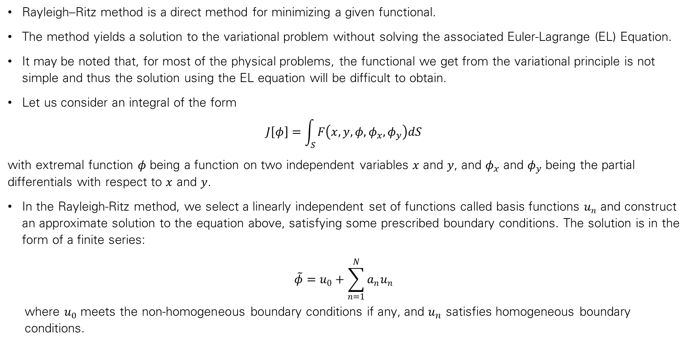
Rayleigh-Ritz Method
Rayleigh–Ritz method is a direct method for minimizing a given functional.
The method yields a solution to the variational problem without solving the associated Euler-Lagrange (EL) Equation.
It may be noted that, for most of the physical problems, the functional we get from the variational principle is not simple and thus the solution using the EL equation will be difficult to obtain.
Let us consider an integral of the form
$$J\left[φ\right]=\int_{S}^{ }{F\left(x,y,φ,φ_{x}, φ_{y}\right)dS}$$
with extremal function $φ$ being a function on two independent variables $x$ and $y$, and $φ_{x}$ and $φ_{y}$ being the partial differentials with respect to $x$ and $y$.
In the Rayleigh-Ritz method, we select a linearly independent set of functions called basis functions $u_{n}$ and construct an approximate solution to the equation above, satisfying some prescribed boundary conditions. The solution is in the form of a finite series:
$$\tilde{φ}=u_{0}+\sum_{n=1}^{N}{a_{n}u_{n}}$$
  where $u_{0}$ meets the non-homogeneous boundary conditions if any, and $u_{n}$ satisfies homogeneous boundary conditions.

Slide 11
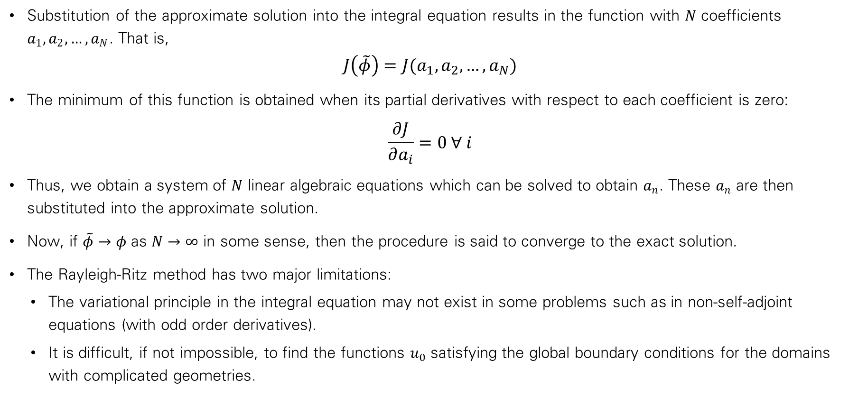
Rayleigh-Ritz Method
Substitution of the approximate solution into the integral equation results in the function with $N$ coefficients $a_{1}, a_{2},…,a_{N}$. That is,
$$J\left(\tilde{φ}\right)=J(a_{1}, a_{2},…,a_{N})$$
The minimum of this function is obtained when its partial derivatives with respect to each coefficient is zero:
$$\frac{∂J}{∂a_{i}}=0 ∀ i$$
Thus, we obtain a system of $N$ linear algebraic equations which can be solved to obtain $a_{n}$. These $a_{n}$ are then substituted into the approximate solution.
Now, if $\tilde{φ}→φ$ as $N→∞$ in some sense, then the procedure is said to converge to the exact solution.
The Rayleigh-Ritz method has two major limitations:
  The variational principle in the integral equation may not exist in some problems such as in non-self-adjoint equations (with odd order derivatives).
  It is difficult, if not impossible, to find the functions $u_{0}$ satisfying the global boundary conditions for the domains with complicated geometries.

Slide 12
Rayleigh-Ritz Method in FEA and Solid Mechanics
The Rayleigh-Ritz method is a classical approximate method used to find the displacement function of an object in equilibrium with externally applied loads.
It's a foundational method that is incorporated into FEM calculations.
The method is based on the Principle of Minimum Potential Energy for conservative systems.
The approach involves:
  Assuming a shape for the unknown displacement functions.
  The displacement functions contain a few unknown parameters.
  These assumed shape functions are called Trial Functions.
  The potential energy function of the system is expressed in terms of these parameters.
  The values of the parameters that minimize the potential energy function are determined.

Slide 13
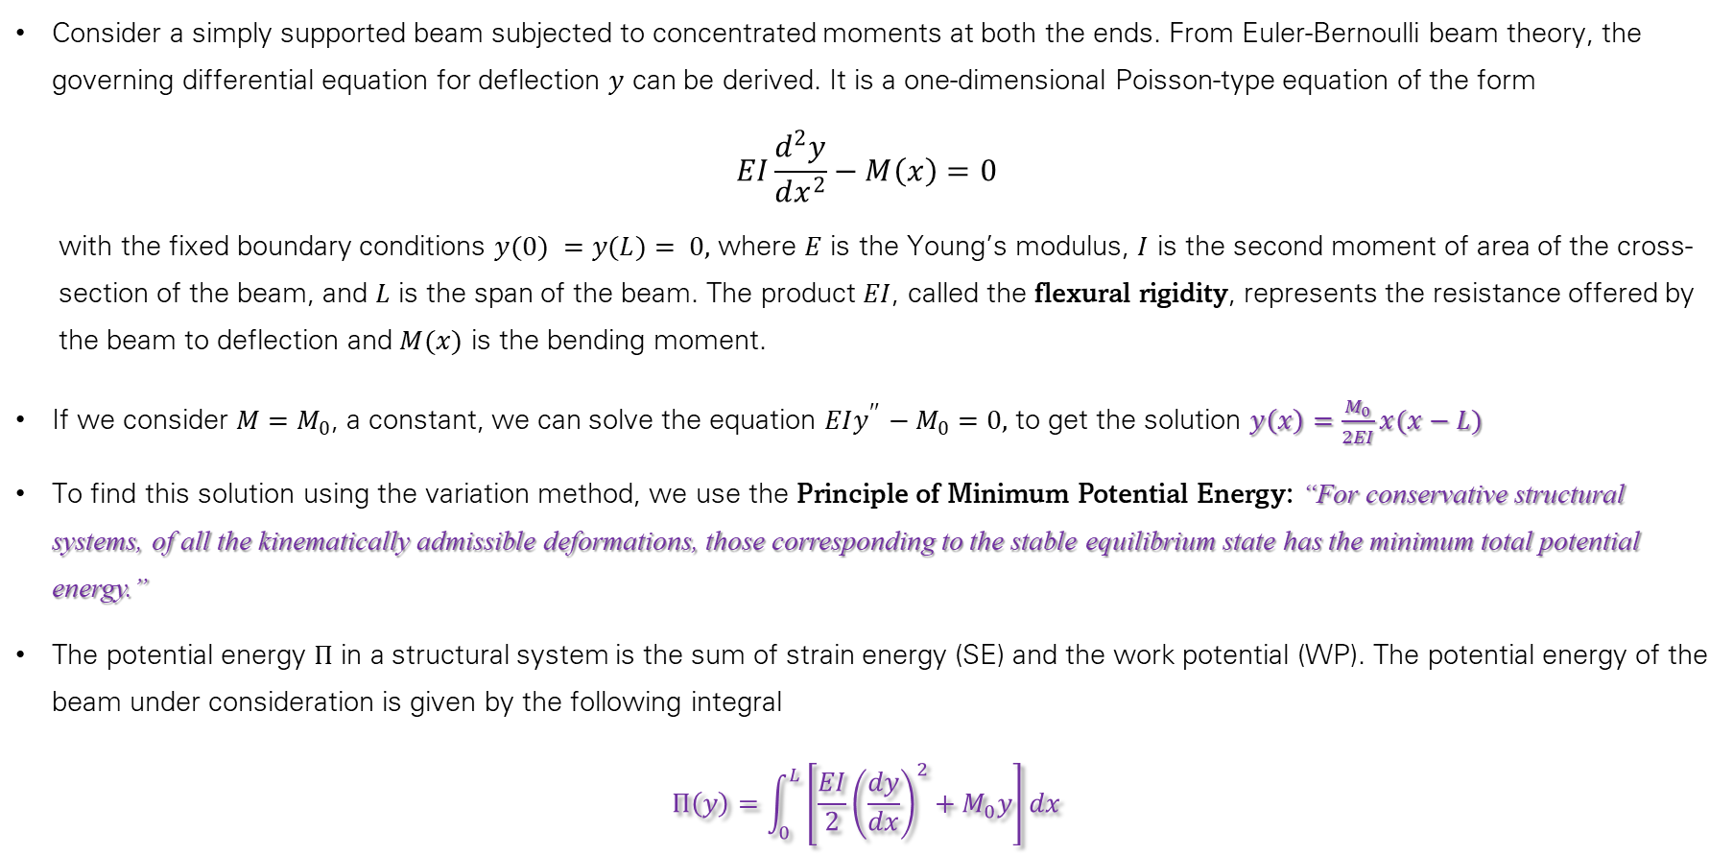
Deflection of Beam – Variational Formulation
Consider a simply supported beam subjected to concentrated moments at both the ends. From Euler-Bernoulli beam theory, the governing differential equation for deflection $y$ can be derived. It is a one-dimensional Poisson-type equation of the form
$$EI\frac{d^{2}y}{dx^{2}}−M\left(x\right)=0$$
  with the fixed boundary conditions $y(0) =y(L)= 0,$ where $E$ is the Young’s modulus, $I$ is the second moment of area of the cross-section of the beam, and $L$ is the span of the beam. The product $EI$, called the flexural rigidity, represents the resistance offered by the beam to deflection and $M(x)$ is the bending moment.
If we consider $M=M_{0}$, a constant, we can solve the equation $EIy^{′′}−M_{0}=0,$ to get the solution $y\left(x\right)=\frac{M_{0}}{2EI}x(x−L)$
To find this solution using the variation method, we use the Principle of Minimum Potential Energy: “For conservative structural systems, of all the kinematically admissible deformations, those corresponding to the stable equilibrium state has the minimum total potential energy.”
The potential energy $Π$ in a structural system is the sum of strain energy (SE) and the work potential (WP). The potential energy of the beam under consideration is given by the following integral
$$Π\left(y\right)=\int_{0}^{L}{\left[\frac{EI}{2}{\left(\frac{dy}{dx}\right)}^{2}+M_{0}y\right]dx}$$

Slide 14

$$R$$

Slide 15
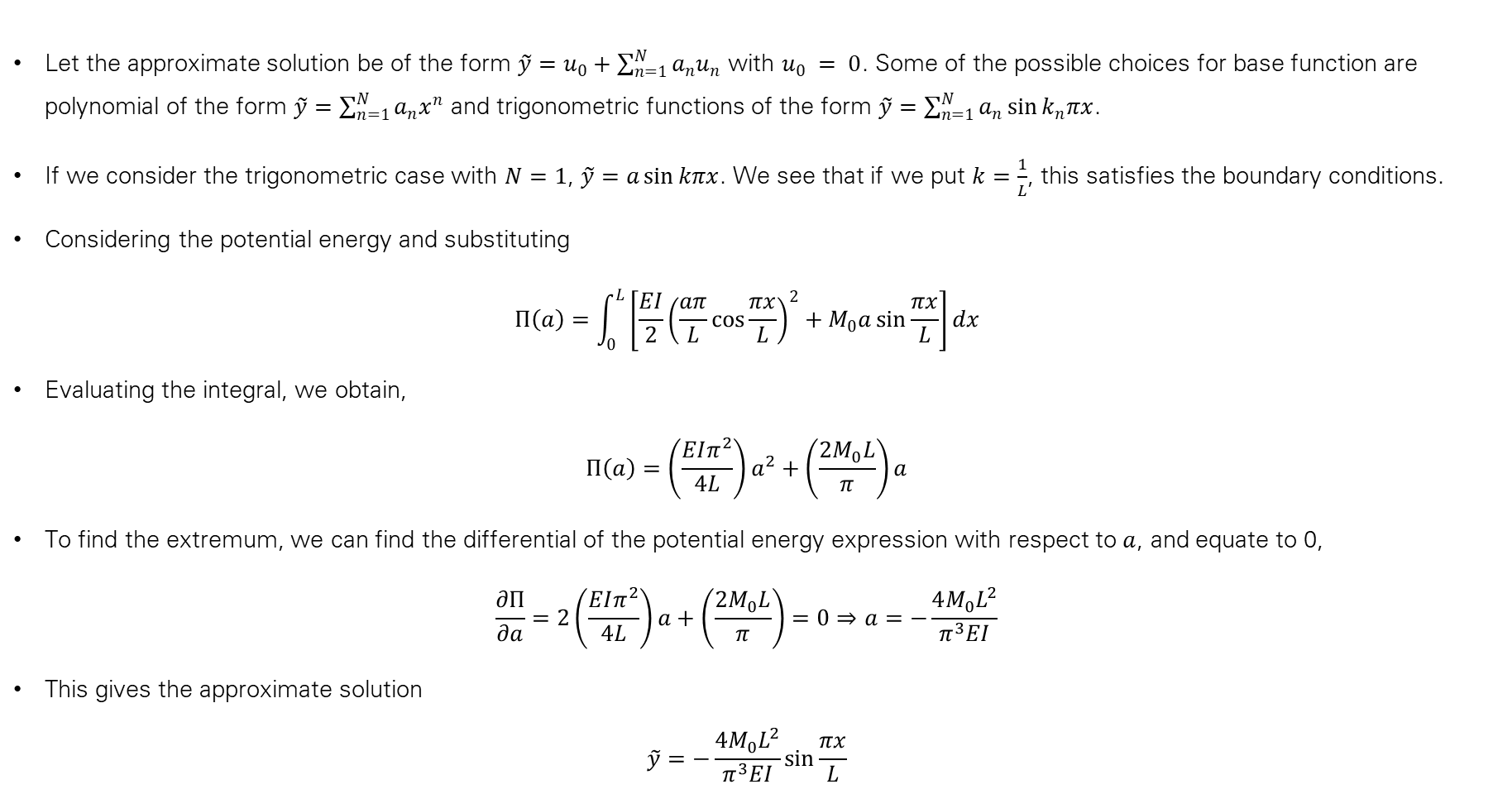
Deflection of Beam – Variational Formulation
Let the approximate solution be of the form $\tilde{y}=u_{0}+\sum_{n=1}^{N}{a_{n}u_{n}}$ with $u_{0} = 0$. Some of the possible choices for base function are polynomial of the form $\tilde{y}=\sum_{n=1}^{N}{a_{n}x^{n}}$ and trigonometric functions of the form $\tilde{y}=\sum_{n=1}^{N}{a_{n}\sin{k_{n}πx}}$.
If we consider the trigonometric case with $N=1$, $\tilde{y}=a\sin{kπx}$. We see that if we put $k=\frac{1}{L}$, this satisfies the boundary conditions.
Considering the potential energy and substituting
$$Π\left(a\right)=\int_{0}^{L}{\left[\frac{EI}{2}{\left(\frac{aπ}{L}cos\frac{πx}{L}\right)}^{2}+M_{0}a\sin{\frac{πx}{L}}\right]dx}$$
Evaluating the integral, we obtain,
$$Π\left(a\right)=\left(\frac{EIπ^{2}}{4L}\right)a^{2}+\left(\frac{2M_{0}L}{π}\right)a$$
To find the extremum, we can find the differential of the potential energy expression with respect to $a$, and equate to 0,
$$\frac{∂Π}{∂a}=2\left(\frac{EIπ^{2}}{4L}\right)a+\left(\frac{2M_{0}L}{π}\right)=0⇒a=−\frac{4M_{0}L^{2}}{π^{3}EI}$$
This gives the approximate solution
$$\tilde{y}=−\frac{4M_{0}L^{2}}{π^{3}EI}\sin{\frac{πx}{L}}$$

Slide 16
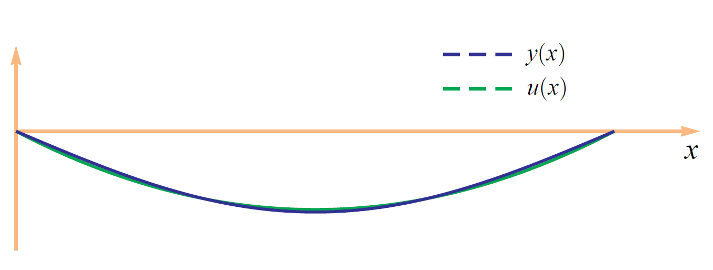
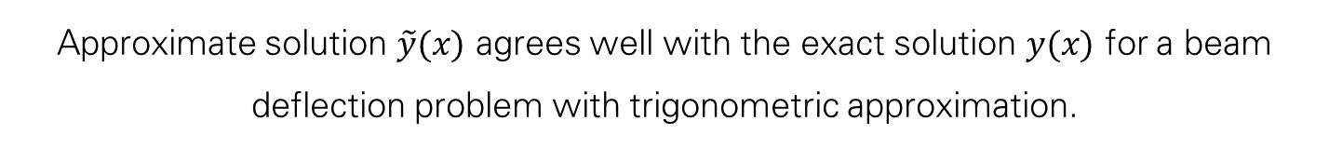
Approximate solution $\tilde{y}(x)$ agrees well with the exact solution $y(x)$ for a beam deflection problem with trigonometric approximation.

Slide 17
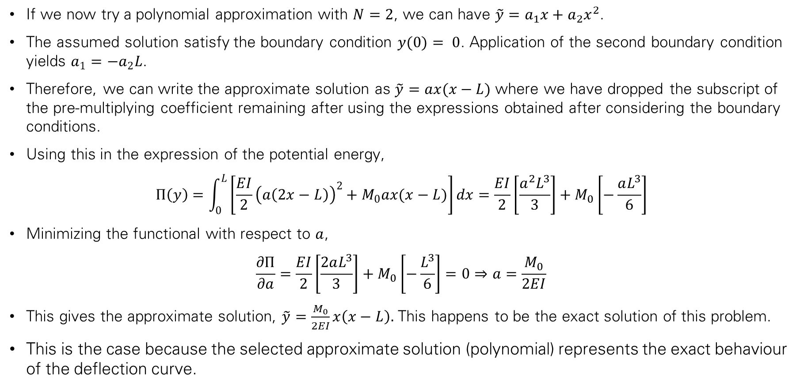
Deflection of Beam – Variational Formulation
If we now try a polynomial approximation with $N=2$, we can have $\tilde{y}=a_{1}x+a_{2}x^{2}$.
The assumed solution satisfy the boundary condition $y(0)= 0$. Application of the second boundary condition yields $a_{1}=−a_{2}L$.
Therefore, we can write the approximate solution as $\tilde{y}=ax(x−L)$ where we have dropped the subscript of the pre-multiplying coefficient remaining after using the expressions obtained after considering the boundary conditions.
Using this in the expression of the potential energy,
$$Π\left(y\right)=\int_{0}^{L}{\left[\frac{EI}{2}{\left(a\left(2x−L\right)\right)}^{2}+M_{0}ax(x−L)\right]dx}=\frac{EI}{2}\left[\frac{a^{2}L^{3}}{3}\right]+M_{0}\left[−\frac{aL^{3}}{6}\right]$$
Minimizing the functional with respect to $a$,
$$\frac{∂Π}{∂a}=\frac{EI}{2}\left[\frac{2aL^{3}}{3}\right]+M_{0}\left[−\frac{L^{3}}{6}\right]=0⇒a=\frac{M_{0}}{2EI}$$
This gives the approximate solution, $\tilde{y}=\frac{M_{0}}{2EI}x\left(x−L\right).$ This happens to be the exact solution of this problem.
This is the case because the selected approximate solution (polynomial) represents the exact behaviour of the deflection curve.

Slide 18
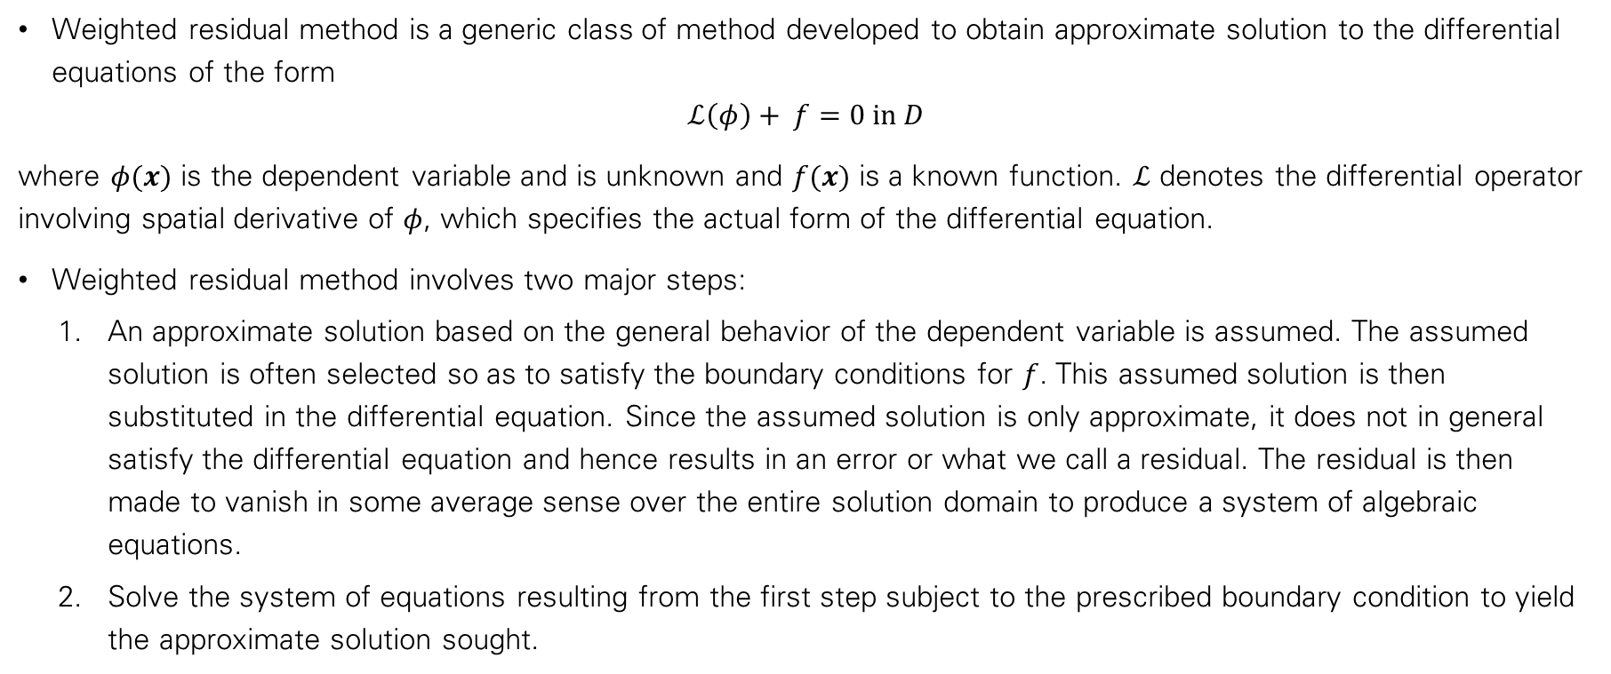
Weighted Residual Methods
Weighted residual method is a generic class of method developed to obtain approximate solution to the differential equations of the form
$$ℒ\left(φ\right)+ f=0 in D$$
where $φ(x)$ is the dependent variable and is unknown and $f(x)$ is a known function. $ℒ$ denotes the differential operator involving spatial derivative of $φ$, which specifies the actual form of the differential equation.
Weighted residual method involves two major steps:
  An approximate solution based on the general behavior of the dependent variable is assumed. The assumed solution is often selected so as to satisfy the boundary conditions for $f$. This assumed solution is then substituted in the differential equation. Since the assumed solution is only approximate, it does not in general satisfy the differential equation and hence results in an error or what we call a residual. The residual is then made to vanish in some average sense over the entire solution domain to produce a system of algebraic equations.
  Solve the system of equations resulting from the first step subject to the prescribed boundary condition to yield the approximate solution sought.

Slide 19
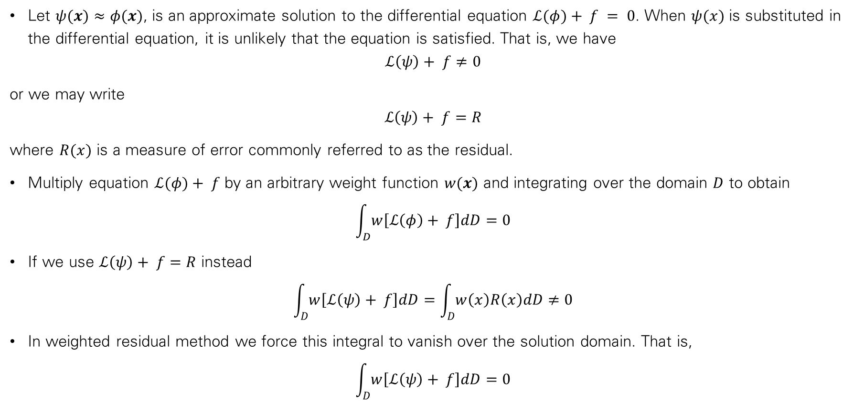
Weighted Residual Methods
Let $ψ(x)≈φ(x)$, is an approximate solution to the differential equation $ℒ(φ)+ f = 0$. When $ψ(x)$ is substituted in the differential equation, it is unlikely that the equation is satisfied. That is, we have
$$ℒ\left(ψ\right)+ f≠0$$
or we may write
$$ℒ\left(ψ\right)+ f=R$$
where $R(x)$ is a measure of error commonly referred to as the residual.
Multiply equation $ℒ(φ)+ f$ by an arbitrary weight function $w(x)$ and integrating over the domain $D$ to obtain
$$\int_{D}^{ }{w\left[ℒ\left(φ\right)+ f\right]dD=0}$$
If we use $ℒ\left(ψ\right)+ f=R$ instead
$$\int_{D}^{ }{w\left[ℒ\left(ψ\right)+ f\right]dD}=\int_{D}^{ }{w\left(x\right)R\left(x\right)dD≠0}$$
In weighted residual method we force this integral to vanish over the solution domain. That is,
$$\int_{D}^{ }{w\left[ℒ\left(ψ\right)+ f\right]dD}=0$$

Slide 20
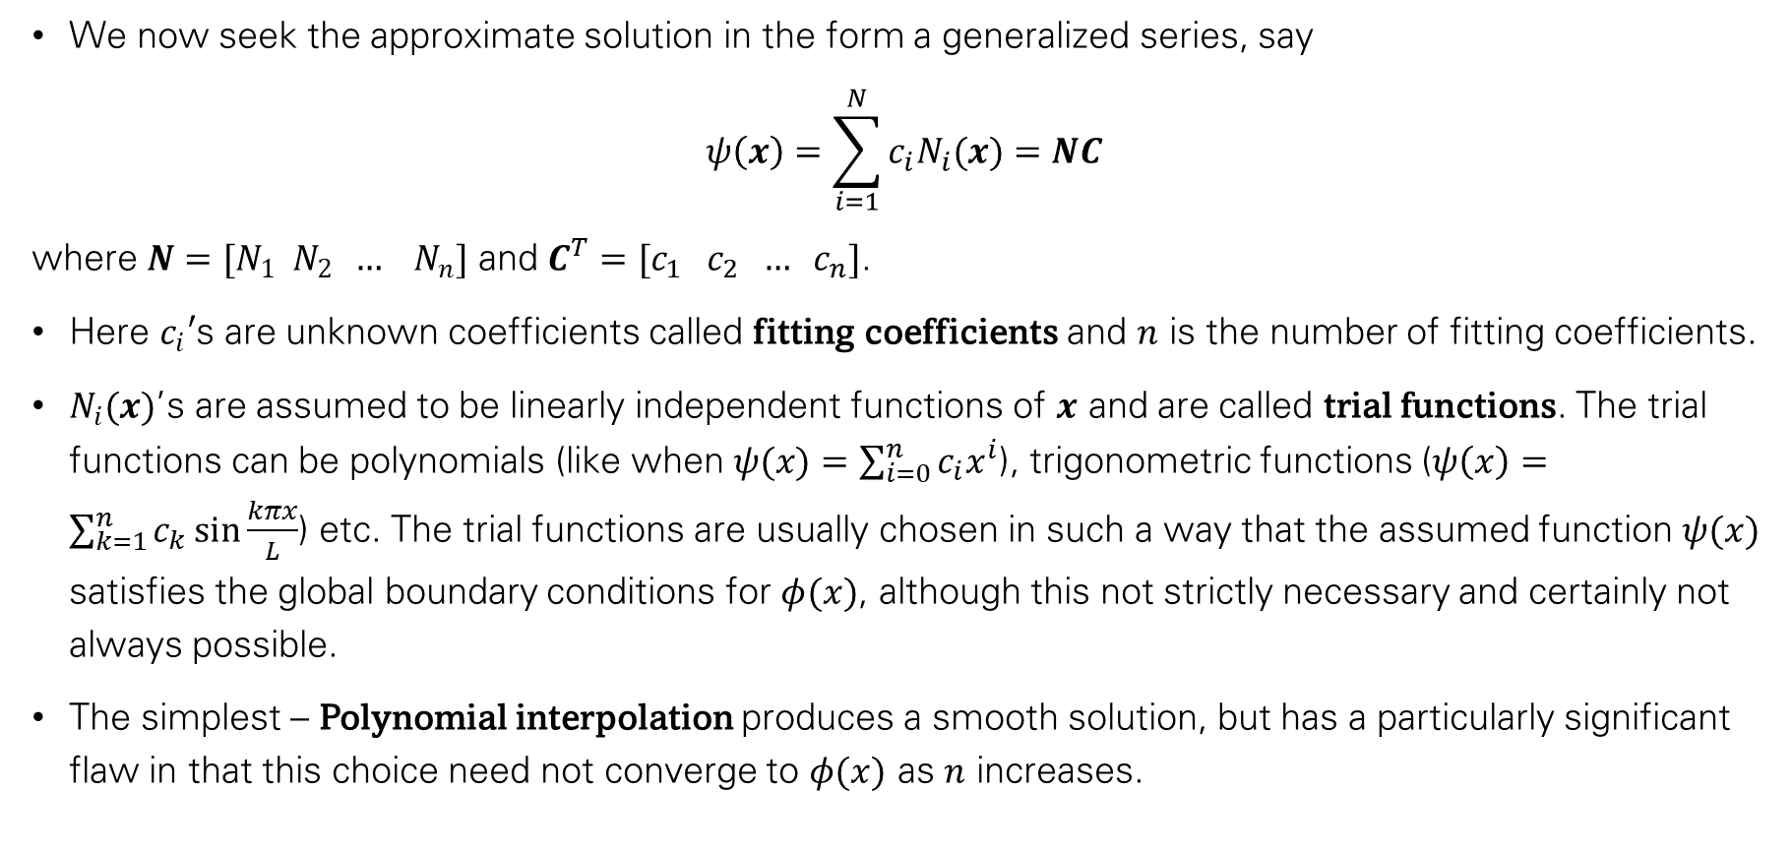
Weighted Residual Methods
We now seek the approximate solution in the form a generalized series, say
$$ψ\left(x\right)=\sum_{i=1}^{N}{c_{i}N_{i}(x)}=NC$$
where $N=[N_{1} N_{2} … N_{n}]$ and $C^{T}=[c_{1} c_{2} … c_{n}]$.
Here $c_{i}′$s are unknown coefficients called fitting coefficients and $n$ is the number of fitting coefficients.
$N_{i}(x)$’s are assumed to be linearly independent functions of $x$ and are called trial functions. The trial functions can be polynomials (like when $ψ(x)=\sum_{i=0}^{n}{c_{i}x^{i}}$), trigonometric functions ($ψ\left(x\right)=\sum_{k=1}^{n}{c_{k}\sin{\frac{kπx}{L}}}$) etc. The trial functions are usually chosen in such a way that the assumed function $ψ(x)$ satisfies the global boundary conditions for $φ(x)$, although this not strictly necessary and certainly not always possible.
The simplest – Polynomial interpolation produces a smooth solution, but has a particularly significant flaw in that this choice need not converge to $φ(x)$ as $n$ increases.

Slide 21

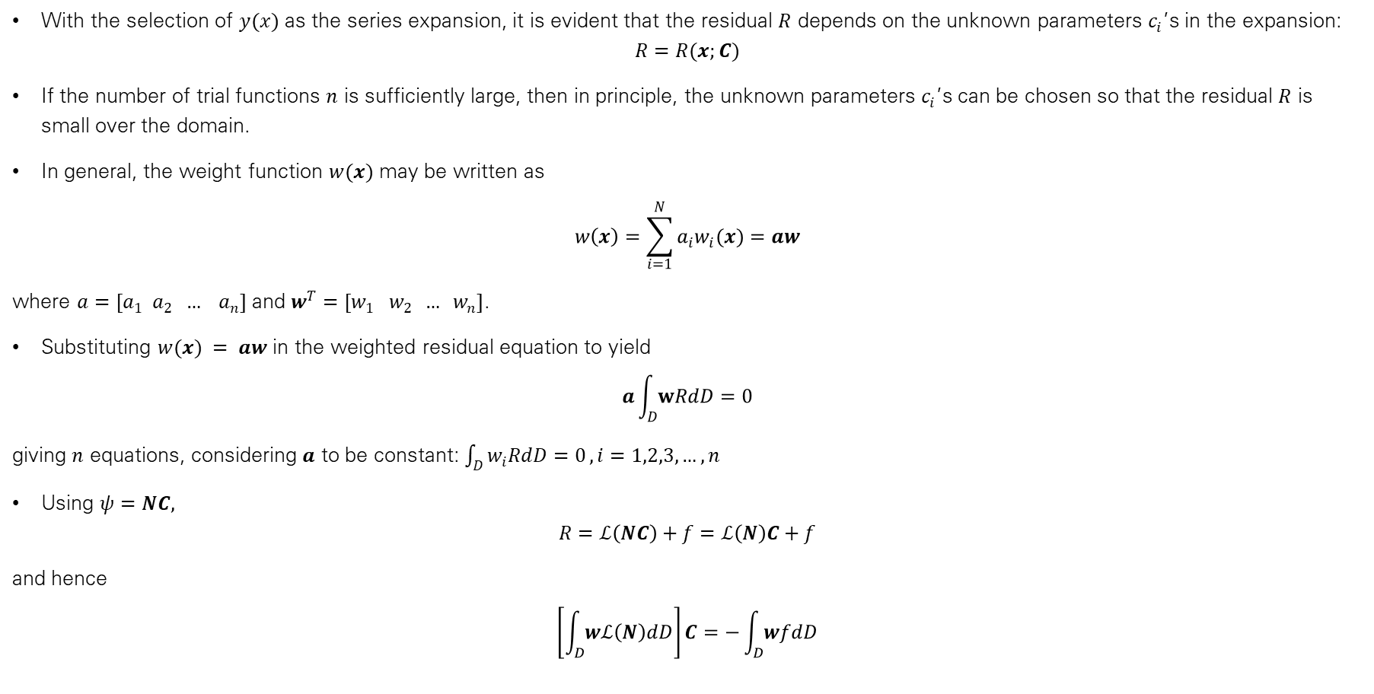


Weighted Residual Methods
With the selection of $y(x)$ as the series expansion, it is evident that the residual $R$ depends on the unknown parameters $c_{i}$’s in the expansion:
$$R=R(x;C)$$
If the number of trial functions $n$ is sufficiently large, then in principle, the unknown parameters $c_{i}$’s can be chosen so that the residual $R$ is small over the domain.
In general, the weight function $w(x)$ may be written as
$$w\left(x\right)=\sum_{i=1}^{N}{a_{i}w_{i}(x)}=aw$$
where $a=[a_{1} a_{2} … a_{n}]$ and $w^{T}=[w_{1} w_{2} … w_{n}]$.
Substituting $w(x) = aw$ in the weighted residual equation to yield
$$a\int_{D}^{ }{wRdD=0}$$
giving $n$ equations, considering $a$ to be constant: $\int_{D}^{ }{w_{i}RdD=0}, i=1,2,3,…,n$
Using $ψ=NC,$
$$R=ℒ\left(NC\right)+f=ℒ\left(N\right)C+f$$
and hence
$$\left[\int_{D}^{ }{wℒ\left(N\right)dD}\right]C=−\int_{D}^{ }{wfdD}$$
$$KC=f$$
$$K$$
$$f$$

Slide 22
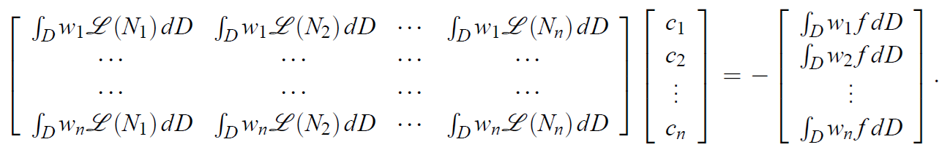

$$KC=f$$

Slide 23
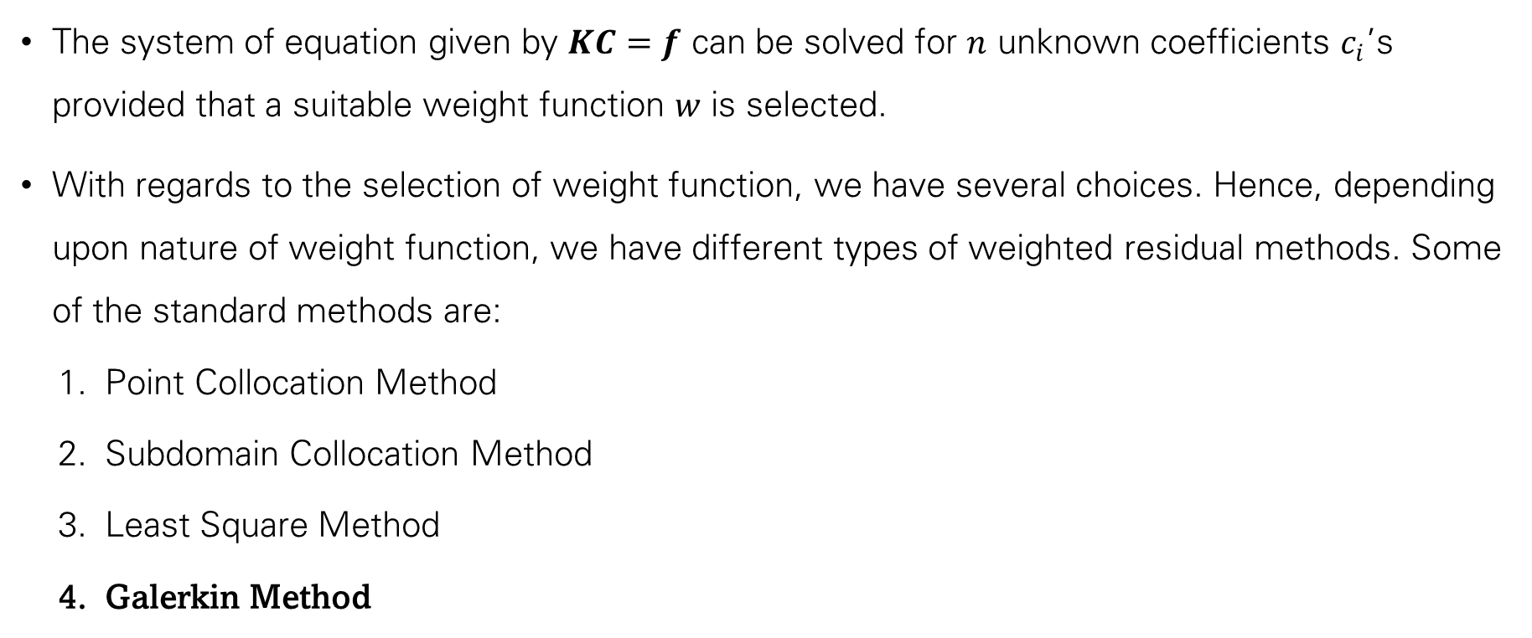
Weighted Residual Methods
The system of equation given by $KC=f$ can be solved for $n$ unknown coefficients $c_{i}$’s provided that a suitable weight function $w$ is selected.
With regards to the selection of weight function, we have several choices. Hence, depending upon nature of weight function, we have different types of weighted residual methods. Some of the standard methods are:
  Point Collocation Method
  Subdomain Collocation Method
  Least Square Method
  Galerkin Method

Slide 24
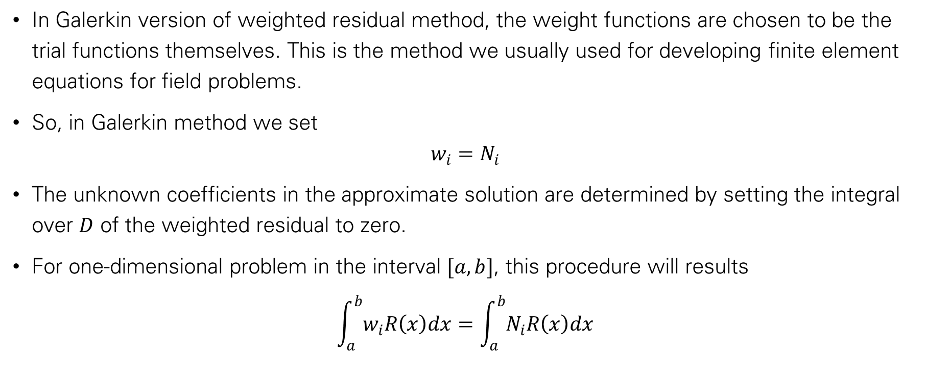
Galerkin Method
In Galerkin version of weighted residual method, the weight functions are chosen to be the trial functions themselves. This is the method we usually used for developing finite element equations for field problems.
So, in Galerkin method we set
$$w_{i}=N_{i}$$
The unknown coefficients in the approximate solution are determined by setting the integral over $D$ of the weighted residual to zero.
For one-dimensional problem in the interval $[a,b]$, this procedure will results
$$\int_{a}^{b}{w_{i}R\left(x\right)dx}=\int_{a}^{b}{N_{i}R\left(x\right)dx}$$

Slide 25
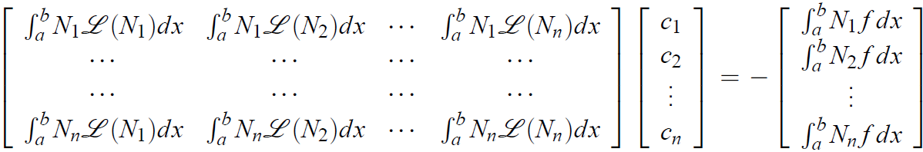
Galerkin Method

Slide 26
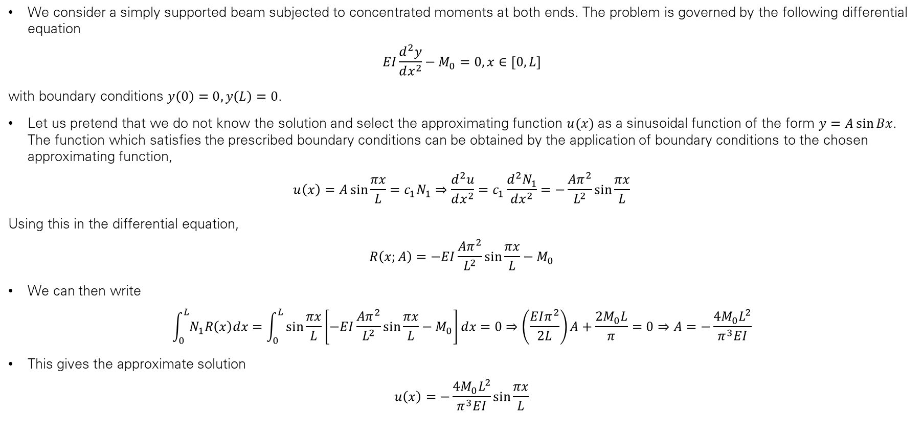
Trigonometric Approximation to Deflection Curve
(Galerkin Method Illustrative Example)
We consider a simply supported beam subjected to concentrated moments at both ends. The problem is governed by the following differential equation
$$EI\frac{d^{2}y}{dx^{2}}−M_{0}=0, x∈[0,L]$$
with boundary conditions $y\left(0\right)=0, y\left(L\right)=0$.
Let us pretend that we do not know the solution and select the approximating function $u(x)$ as a sinusoidal function of the form $y=A\sin{Bx}$. The function which satisfies the prescribed boundary conditions can be obtained by the application of boundary conditions to the chosen approximating function,
$$u\left(x\right)=A\sin{\frac{πx}{L}}=c_{1}N_{1}⇒\frac{d^{2}u}{dx^{2}}=c_{1}\frac{d^{2}N_{1}}{dx^{2}}=−\frac{Aπ^{2}}{L^{2}}\sin{\frac{πx}{L}}$$
Using this in the differential equation,
$$R\left(x;A\right)=−EI\frac{Aπ^{2}}{L^{2}}\sin{\frac{πx}{L}}−M_{0}$$
We can then write
$$\int_{0}^{L}{N_{1}R\left(x\right)dx}=\int_{0}^{L}{\sin{\frac{πx}{L}}\left[−EI\frac{Aπ^{2}}{L^{2}}\sin{\frac{πx}{L}}−M_{0}\right]dx}=0⇒\left(\frac{EIπ^{2}}{2L}\right)A+\frac{2M_{0}L}{π}=0⇒A=−\frac{4M_{0}L^{2}}{π^{3}EI}$$
This gives the approximate solution
$$u\left(x\right)=−\frac{4M_{0}L^{2}}{π^{3}EI}\sin{\frac{πx}{L}}$$

Slide 27
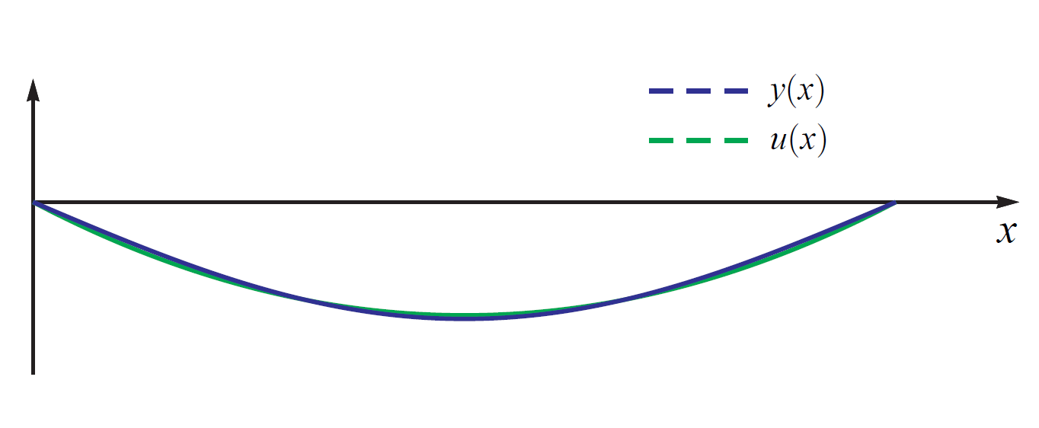

Slide 28
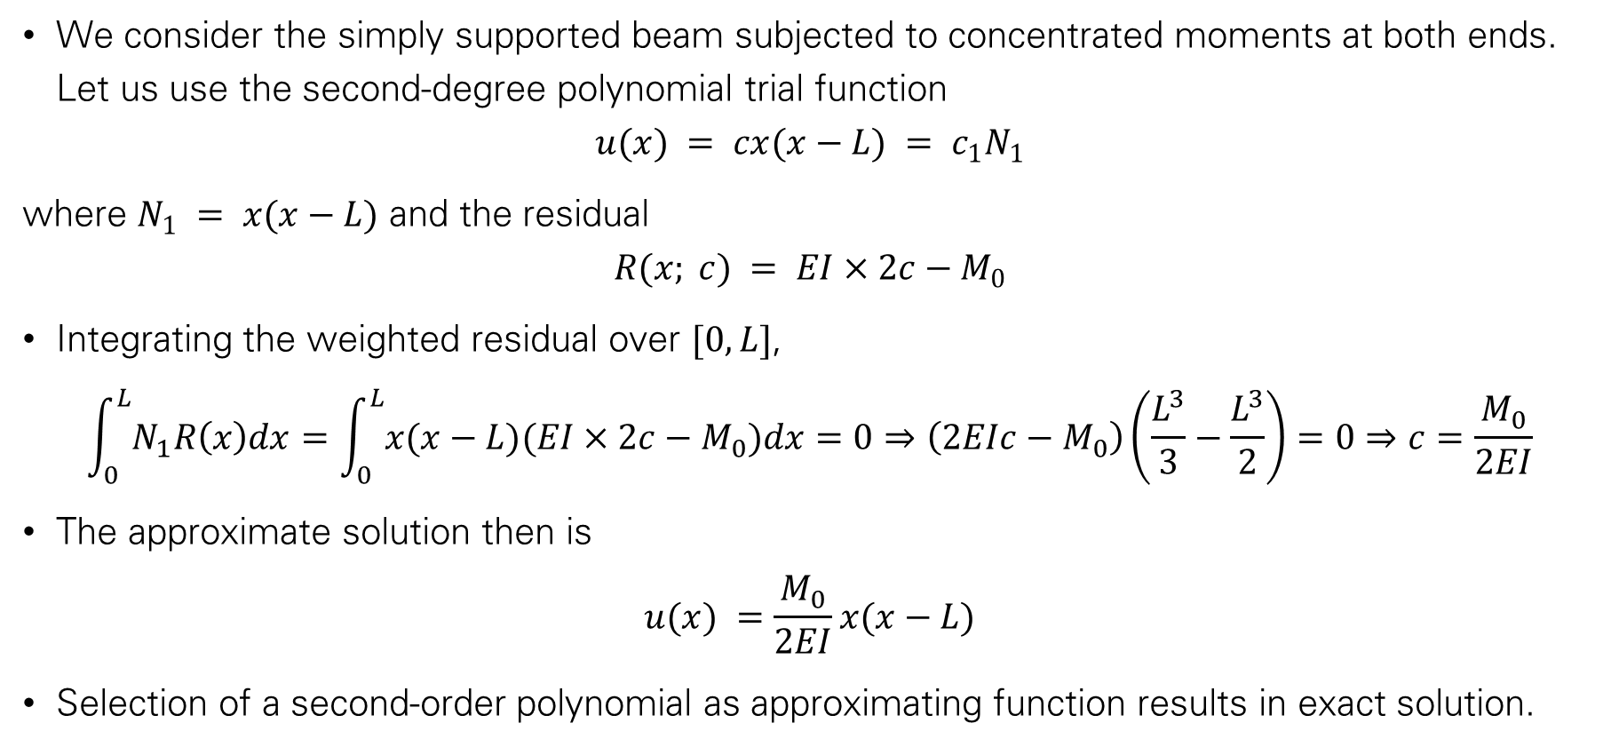
Polynomial Approximation to Deflection Curve
(Galerkin Method Illustrative Example)
We consider the simply supported beam subjected to concentrated moments at both ends. Let us use the second-degree polynomial trial function
$$u(x) = cx(x−L) = c_{1}N_{1}$$
where $N_{1} = x(x−L)$ and the residual
$$R(x; c) = EI×2c−M_{0}$$
Integrating the weighted residual over $[0,L]$,
$$\int_{0}^{L}{N_{1}R\left(x\right)dx}=\int_{0}^{L}{x(x−L)(EI×2c−M_{0})dx}=0⇒\left(2EIc−M_{0}\right)\left(\frac{L^{3}}{3}−\frac{L^{3}}{2}\right)=0⇒c=\frac{M_{0}}{2EI}$$
The approximate solution then is
$$u(x) =\frac{M_{0}}{2EI}x(x−L)$$
Selection of a second-order polynomial as approximating function results in exact solution.

Slide 29
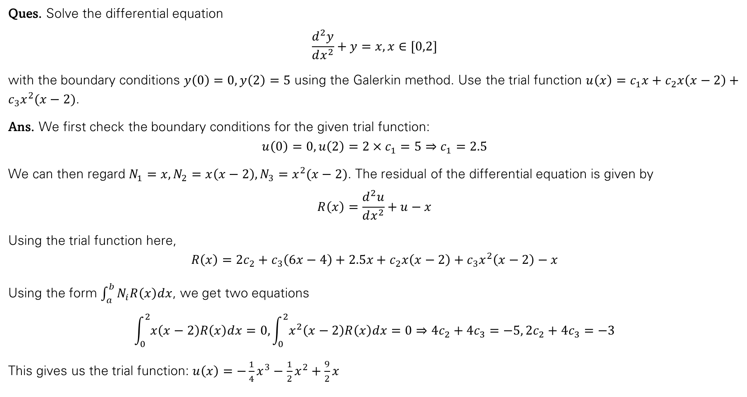
Example
Ques. Solve the differential equation
$$\frac{d^{2}y}{dx^{2}}+y=x, x∈[0,2]$$
with the boundary conditions $y\left(0\right)=0, y\left(2\right)=5$ using the Galerkin method. Use the trial function $u\left(x\right)=c_{1}x+c_{2}x\left(x−2\right)+c_{3}x^{2}(x−2)$.
Ans. We first check the boundary conditions for the given trial function:
$$u\left(0\right)=0, u\left(2\right)=2×c_{1}=5⇒c_{1}=2.5$$
We can then regard $N_{1}=x, N_{2}=x\left(x−2\right), N_{3}=x^{2}(x−2)$. The residual of the differential equation is given by
$$R\left(x\right)=\frac{d^{2}u}{dx^{2}}+u−x$$
Using the trial function here,
$$R\left(x\right)=2c_{2}+c_{3}\left(6x−4\right)+2.5x+c_{2}x\left(x−2\right)+c_{3}x^{2}\left(x−2\right)−x$$
Using the form $\int_{a}^{b}{N_{i}R\left(x\right)dx}$, we get two equations
$$\int_{0}^{2}{x\left(x−2\right)R\left(x\right)dx}=0,\int_{0}^{2}{x^{2}\left(x−2\right)R\left(x\right)dx}=0⇒4c_{2}+4c_{3}=−5, 2c_{2}+4c_{3}=−3$$
This gives us the trial function: $u\left(x\right)=−\frac{1}{4}x^{3}−\frac{1}{2}x^{2}+\frac{9}{2}x$

Slide 30
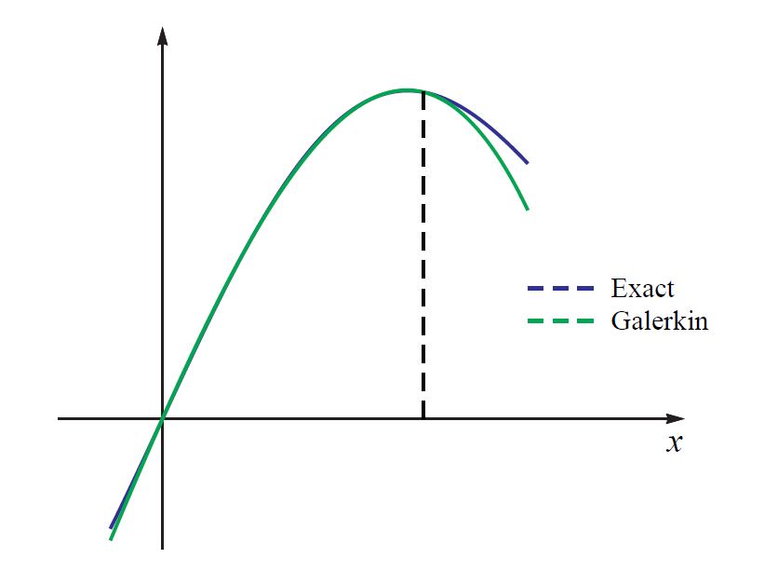

Slide 31
In the Finite Element Method, we will have a residual equation for each element, if we use the Galerkin Method.

